Slide 1
Predicting Film Profitability with Multiple Regression
Demond Love

Slide 2
Statistical Question
The central statistical question that I am exploring is if it is possible to predict the profitability of a film, with a high degree of certainty, using multiple regression?
I hypothesize that we will be able to create a strong, yet incomplete model from the data in the Kaggle TMDB 5000 Movie dataset.

Slide 3
Purpose
Predicting the profitability of a film is a complex problem, which depends on many factors that can be unforeseen at the outset of the filmmaking process. Although many of these factors cannot be accounted for, including competing films or events, cast popularity, economic/political happenings, there are many factors that can not only be accounted for, but also controlled. Therefore, having an accurate gauge on the levers that ultimately control the financial success of a film is highly beneficial to film financiers and filmmakers. As one of the most popular forms of entertainment, filmmaking has always been a highly profitable industry. However, this is also an extremely high-risk industry, built on the back of summer blockbusters that often cost hundreds of millions of dollars. With such large sums of money on the line with every summer blockbuster, it is extremely important that movie studios carefully control the profitability of each and every film.
To this end, I will be researching the relationships between various variables and the revenue that each film generates. Using the TMDb 5000 Movie Dataset, I will use statistical analysis to identify and quantitatively define the these relationships. The ability to predict the financial outlook of planned projects would allow production companies to make smarter decisions, better plan their resources, have an edge in the industry.

Slide 4
Dataset
I came to this dataset from Kaggle, who received the information from The Movie Database (TMDb) API. TMDb is a community build movie and TV database dating back to 2008, providing movie metadata. This dataset was generated from The Movie Database API. This product uses the TMDb API but is not endorsed or certified by TMDb. Their API also provides access to data on many additional movies, actors and actresses, crew members, and TV shows. The dataset hasn’t yet gone through a data quality analysis, wherefore there are multiple missing values throughout the dataset and it is currently unknown if the budgets and revenues are all in US Dollars.
TMDb 5000 Movie Dataset. Retrieved June 24, 2018. https://www.kaggle.com/tmdb/tmdb-movie-metadata

Slide 5
Dataset Variables
1. Budget: Estimated budgets of each film, in USD.
2. Genres: Film categories that each film, and there can be multiple genres for each film.
3. Homepage: This is the website URL setup to provide information on the film.
4. ID: Unique identifier for each film.
5. Keywords: User-definied keywords that relate to the film and it's subject matter.
6. Original_language: Language the film was first recorded in.
7. Original_title: Title given to a film during it's production and may different from the final title seen on it's release.
8. Overview: This is a synopsis of the film.
9. Popularity: This is an aggregate value of the number of times this page was visited on TheMovieDatabase.com.
10. Production_companies: Companies responsible for the financing, releasing, and production of the film.

Slide 6
Dataset Variables (cont.)
11. Production_countries: Countries the film was recorded in during production.
12. Release_date: Date the film had it's theatrical release.
13. Revenue: Amount of money grossed at the boxoffice for the film.
14. Runtime: Length of time the film runs.
15. Spoken_languages: Languages that the film was recorded in, plus any it was translated to for distribution.
16. Status: This is the production status; it is either released, post-production, or rumored.
17. Tagline: This is the marketing slogan given to the film.
18. Title: This is the name the film had upon it's release.
19. Vote_average: This is the average rating given to each film, on a scale of 1 - 10.
20. Vote_count: This is the number of votes cast for each film in the vote_average variable.

Slide 7
Five Analysis Variables
The five variables that I have chosen to explore are film's budget, the revenue, the runtime, the vote_average, and another variable that will need to be added, which is profit.
A film's budget is extremely important, since I hypothesize that for audiences to feel a movie is worth seeing in the theater, that it must be a large-scale film with explosions and special effects; both of which significantly drive up a film's budget.
A film's revenue is an important metric to consider, since it represents how much money a film pulled in at the box office.
A film's runtime is one that could be important for the same reason as a budget. I hypothesize that for audiences to feel a movie is worth seeing in the theater, that it must be a longer film, so feel as if they are getting their money's worth on entertainment.
A film's vote_average is important because it is a measure of the film's quality; how much audiences enjoyed the film after seeing it. Although this will not drive up opening weekend numbers, it will drive word-of-mouth. I hypothesize that the higher a movie's quality, then the more money it will make.
Lastly, is the metric that will be used to measure a film's success; it's profit. This is a variable that I will need to create by subtracting revenue from budget.

Slide 8
Budget Variable
Mean: 42297943.0
Mode: 20000000
Variance: 2.014437e+15
Standard Deviation: 44882480.0

Slide 9
Revenue Variable
Mean: 127429483.0
Variance: 3.582998e+16
Standard Deviation: 189288092.0

Slide 10
Runtime Variable
Mean: 111.0
Mode: 100
Variance: 4.410000e+02
Standard Deviation: 21.0

Slide 11
Vote Average Variable
Mean: 6.0
Mode: 6
Variance: 1.000000e+00
Standard Deviation: 1.0

Slide 12
Profit Variable
Mean: 85131540.0
Mode: -14000000
Variance: 2.594807e+16
Standard Deviation: 161084036.0

Slide 13
Outliers
Within the dataset, the runtime distribution is extremely skewed. So, after looking at films with runtimes over 200, I found that the longest film, Carlos, isn’t actually a feature film, but is instead a television miniseries. Therefore, it is not actually from the population in which we are looking to pull from and should be excluded. However, the others do appear to be legitimate feature films with theatrical releases.
Also, within the budget distribution there was a surprising amount of micro-budget movies and a movie that cost almost 400 million dollars. I’ve heard of Transformers and Avatar films costing 200 million, but this high of a number would need to be investigated. Only one record in the dataset that looks out of place is Pirates of the Caribbean: On Stranger Tides. It is recorded as 380 million dollars. However, other sources, do validate this amount. According to Forbes, it is actually 410 million dollars, so this is actually a conservative estimate. Source: https://www.forbes.com/sites/csylt/2014/07/22/fourth-pirates-of-the-caribbean-is-most-expensive-movie-ever-with-co #70a84bd8364f

Slide 14
Outliers (cont.)
After doing more research, none of these movies are legitimate. However, they are conversions not to the dollar, but instead 10 means 10 million for Nurse 3-D, according to The Guardian. Same with Rugrats, according to BoxOfficeMojo. According to the same source, the film actually only made 5k on limited release. The same million unit conversion also holds true for Rugrats revenue. Same for The 51st State, Split Second, and The Prophecy. However, according to BoxOfficeMojo, this isn’t true for Angela’s Ashes. In fact, it cost 50 million dollars to make and made $13,042,112. However, Modern times is completely off and can be removed. Sources:
https://www.theguardian.com/film/2015/jul/21/paz-de-la-huerta-sues-director-of-sex-horror-nurse-3d-for-ruining-her-career
https://web.archive.org/web/20140401011944/http://boxofficemojo.com/movies/?id=rugratsinparis.htm https://www.the-numbers.com/movie/Angelas-Ashes#tab=summary
https://www.the-numbers.com/ movie/Split-Second#tab=summary
http://www.boxofficemojo.com/movies/?id=prophecy95.htm
http://www.boxofficemojo.com/movies/?id=angelasashes.htm
There are revenues that should be multiplied by 1,000,000 also. In the Cut should be 23 million, per BoxOfficeMojo. Same with Chasing Liberty. Same with Death at a Funeral. Sources.
http://www.boxofficemojo.com/movies/?id=inthecut.htm
http://www.boxofficemojo.com/movies/?id= chasingliberty.htm
http://www.boxofficemojo.com/movies/?id=deathatafuneral.htm

Slide 15
Probability Mass Function
Here, I will use a PMF to research the relationship with film length and vote_average, by graphing the probability mass function for the vote_average variable, after it has been divided into two groups based on film runtime length.
This graph allows us to answer the question of if users prefer longer or shorter films on average.
As you can see by the skewness of each subset of the vote_average variable, users do prefer longer films on average. This is evidenced by the fact that the highest rated films belong to the longer films subset (the light blue line extends further to the right). And the highest peak for the longer films subset is further to the right on the graph.
Dark Blue Line: Films shorter than 90 minutes
Light Blue Line: Films longer than 90 minutes

Slide 16
Cumulative Distribution Function
Probability Mass Functions work well if the number of values is small, like vote_average. But as the number of values increases, like with revenue, the probability associated with each value gets smaller and the effect of random noise increases. There problems can be mitigated by using the cumulative distribution function. The Cumulative Distribution Function is a function that maps from a value to its percentile rank.
One way to read this is that about 95% of films gross less than half a billion dollars.
The steepest portion of the graph is close closest to zero. Therefore, what this graph tells us is that most films don’t gross a lot of money at the box office, but a very small percentage gross an extraordinary amount of money.
This doesn’t directly address the question of if it is possible to predict, with a high level of certainty, if we can predict a film’s success, but it does let us know that what is most common amongst all the films is not likely what can best explain film success.

Slide 17
Analytical Model – Normal Distribution
I have chosen to use the normal distribution analytical model to explore the budget variable. Based on what we learned in the last slide, that the vast majority of films do gross close to nothing, this means that we also know that the distribution of revenue is extremely skewed. Therefore, any reliable predictor of an extremely skewed distribution must itself be an extremely skewed.
Since I previously hypothesized that for audiences to feel a movie is worth seeing in the theater, that it must be a large-scale film with explosions and special effects; both of which significantly drive up a film's budget. Then, if this is to hold true, I expect the normal distribution to not be a good model for the budget variable.

Slide 18
Analytical Model – Normal Distribution (cont.)
As shown by the large gaps between the model line and the data line, a normal distribution is not a quality model for data.
Therefore, this means that we cannot rule out that budget is a significant predictor of the financial success of a film.

Slide 19
Relationship between Profit & Budget
Covariance to measure the tendency of the two variables to vary together. The covariance of these variables is 3929014024282456.0.
A more useful, and standardized covariance value is the Pearson Correlation Coefficient, which is 0.5438449953498812.
Looking at the scatterplot allows us to go beyond the Pearson correlation and look at if there is a nonlinear relationship between the variables that is not reflected in the correlation coefficient, which only measures linear relationships. However, looking at the scatterplot, there are no visible nonlinear relationship between profit and budget. It is instead a moderate linear relationship.

Slide 20
Relationship between Profit & Average Rating
Covariance to measure the tendency of the two variables to vary together. The covariance of these variables is 30489404.113659065.
A more useful, and standardized covariance value is the Pearson Correlation Coefficient, which is 0.22829178515324627.
Looking at the scatterplot allows us to go beyond the Pearson correlation and look at if there is a nonlinear relationship between the variables that is not reflected in the correlation coefficient, which only measures linear relationships. However, looking at the scatterplot, there are no visible nonlinear relationship between profit and average rating. It is instead a weak linear relationship.

Slide 21
Hypothesis Testing a Correlation
Next, I will perform hypothesis testing on the correlation of runtime and profit. At the onset, I hypothosized that a film's runtime is one that could be important for the same reason as a budget. Reason being that for audiences to feel a movie is worth seeing in the theater, that it must be a longer film, so feel as if they are getting their money's worth on entertainment.
For my test statistic, I will use Pearson's correlation and I will do a two-sided test using the absolute correlation. The null hypothesis is that there is no correlation between a film's profit and a film's runtime.
As you can see on the following slide, this hypothesis is correct, the test statistic is statistically significant and we can use this to reject the null hypothesis.

Slide 22


Hypothesis Testing a Correlation (cont.)
The reported p-value:
The reported p-value is 0, which means that in 1000 trials we didn't see a correlation, under the null hypothesis, that exceeded the observed correlation. That means that the p-value is probably smaller than 1/1000, but it is not actually 0.
To get a sense of how unexpected the observed value is under the null hypothesis, we can compare the actual correlation to the largest value we saw in the simulations.
Here we can see the Pearson Correlation Coefficient and the highest coefficient calculated in the 1000 trials:

Slide 23

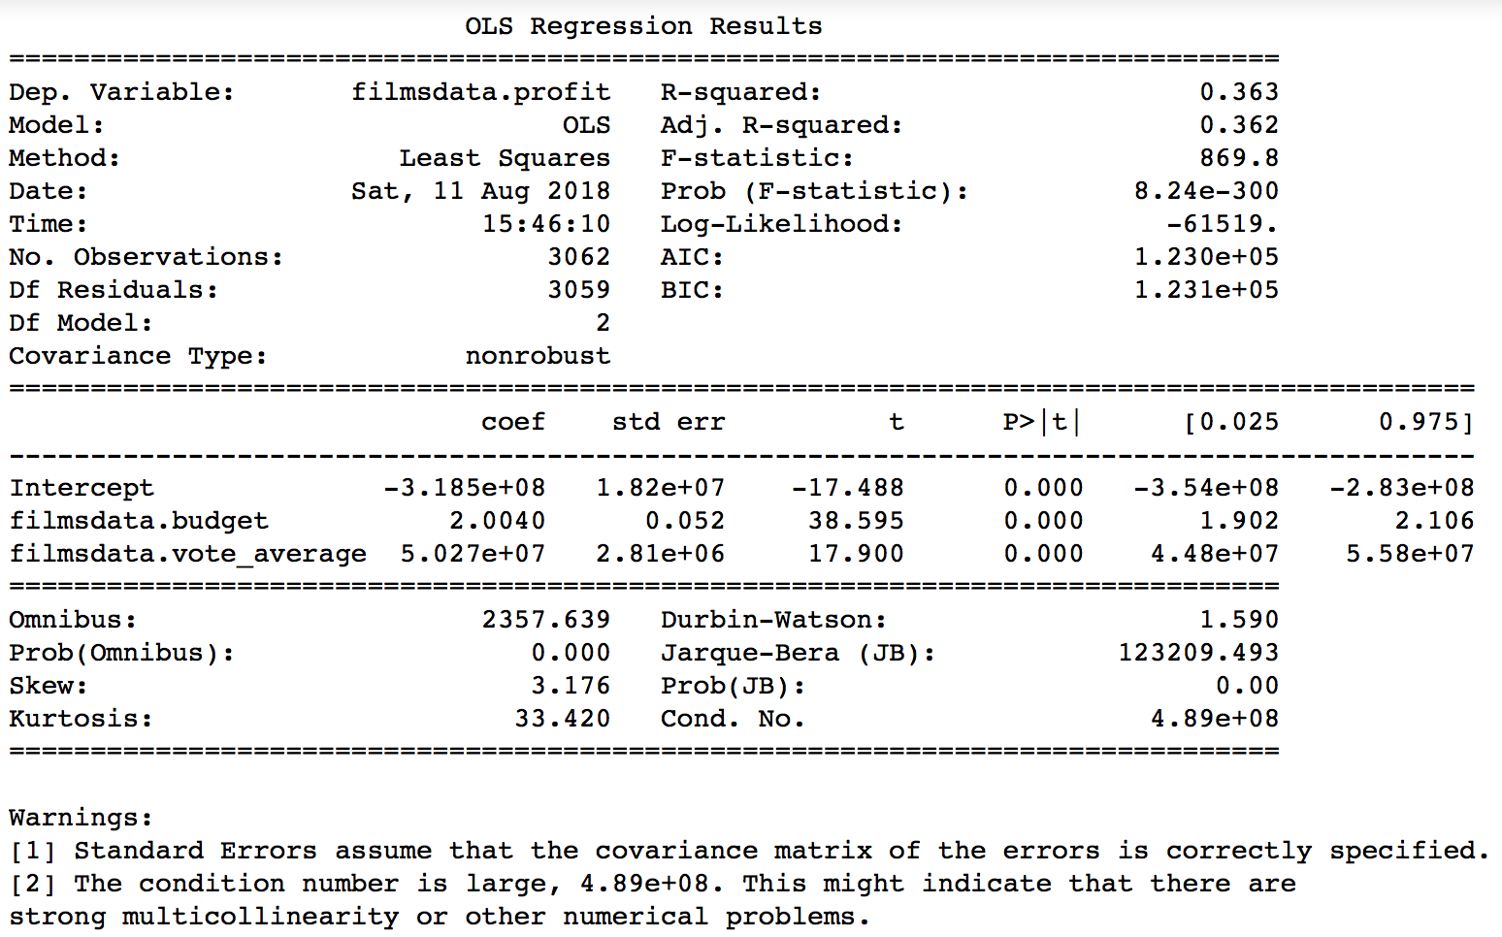
Multiple Regression

Slide 24
Analysis Summarization
With this analysis, we can confirm my initial hypothesis that we create a strong, yet incomplete model from the data in the Kaggle TMDB 5000 Movie dataset. This is evidenced by the multiple regression model's R-squared value. This value provides a measure of how well the model as a whole explains the values of the dependent variable. Therefore, our model explains over 36% of the variation in a film's profit. Since models with more features always explain more variation, the adjusted R-squared value corrects R-squared by penalizing models with a large number of independent variables. For our model, R-squared and adjusted R-squared values are pretty much the same. Also, as shown by the F-statistic and it’s p-value, this finding is statistically significant, which means that we can reject the null hypothesis that we cannot create a model to predict the profitability of a film using multiple regression
This analysis allows us to conclude that that runtime and quality, denoted by it’s average rating, don’t have a meaningful effect on the film’s financial success, but the film’s budget does have a significant impact. Therefore, it can be said that to maximize ones profitability, one must make a significant investment in terms of budget. However, if you are to make a smart investment, then more must be known regarding the film in question, since our model only predicts at most a mediocre amount of the variability in the film’s financial success.

